Slide 1
SYSTEM ARCHITECTURE
TREATMENT MODULE
Virtual Spray Robots
(Spraying appropriate medicine to the affected plants precisely)
4
ASSESSMENT MODULE
Legitimate researchers + Expert farmers
(Analyzing the predicted diseases and suggesting an appropriate treatment)
3
PREDICTION MODULE
Ledger of sink nodes
(Predicting the crop diseases using various techniques and algorithms)
2
DATA AGGREGATION MODULE
Sensors + Drone Cameras
(Studying and collecting data on the basis of different parameters)
1
01

Slide 2
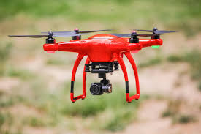
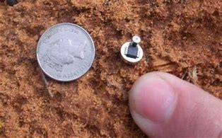
DATA AGGREGATION MODULE
Sensors and drone cameras deployed in the fields
Sensors studying plant and environment parameters
Sensors trained beforehand according to vegetation,
terrain and climatological conditions of the farm
Drone cameras capturing images of different plant
portions
Data segregated on the basis of plant’s unique
identification number
Data aggregated report generated and transmitted
periodically to the sink node of the particular farm
02

Slide 3
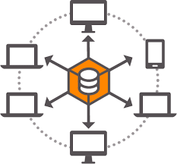
Prediction module
Module subsumes the sink nodes of farms as the nodes of
the blockchain ledger
Sink nodes receives the data aggregated report
Numeric data obtained in the report is calculated using
different machine learning algorithms
Predictions made on the basis of calculations and
processed images
Predicted information sent to the other node of the ledger
Consensus formed on the basic data sets of different areas
The details of the predicted disease is encrypted into a
prediction report and transmitted to assessment module [3, 4]
03

Slide 4
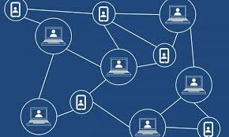
ASSESSMENT MODULE
Module subsumes researchers and modern farmers as the nodes
Nodes receive the encrypted prediction report and decrypt it
Experts perform research work and suggest an appropriate treatment of
the predicted disease
The best treatment is obtained through consensus developed on the
majority basis
This information is added to all the nodes in the form of block
serving to be immutable past record
Treatment report generated consisting details of the appropriate
treatment and transmitted to the treatment module [4]
04

Slide 5
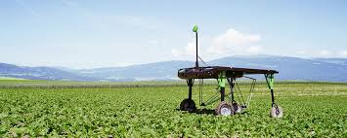
TREATMENT MODULE
Module comprises of virtual spray robot
Robot receives the treatment report
It locomotes and approaches the targeted crop and
spray medicines precisely on the affected areas
Module accustomed for infrared obstacles
avoidance
05

